Slide 1



TI FTRC
Advanced Algorithms for THz Sensing and Recognition
Dr. Murat Torlak
Dr. Yiorgos Makris
Josiah Smith
University of Texas at Dallas
March 10th, 2020 Review

Slide 2
Outline
Dynamic Hand Gesture Recognition
Cost efficiency of proposed preprocessing techniques
New Applications
Conveyor belt scenario
Hidden item counting
Medication packaging
Future applications
Conclusions and Future Work

Slide 3
Dynamic Hand Gesture Recognition

Slide 4
Dynamic Dataset: Results and Size
Dataset 4 – 600/class
512 frames over 2.56s (5ms PRI)
Captured across different days, same subject
Size of data for each class (64, 12, 512, 600)
64: range bins (25 bins containing torso and hand)
12: virtual antennas
512: slow-time (frame index)
600: captures/class
Larger Dataset in Progress – Feedback Requested

Slide 5
3-Tx, 4-Rx Channels Used
Preprocessing Technique
Range FFT
Range, Doppler
Range, Doppler Filtered
Range, Angle
Range, Angle, Doppler
Range FFT, Doppler STFT Filtered
Range, Angle, Doppler STFT Filtered
Data Size / Class
(25, 12, 512, 600)
(25, 12, 512, 600)
(25, 12, 64, 600)
(25, 16, 64, 600)
(25, 16, 64, 600)
(25, 12, 13, 64, 600)
(25, 16, 13, 64, 600)
Efficiency
98.8% / 28ms
99.2% / 29ms
98.2% / 15ms
99% / 16ms
99.2% / 19ms
97.5% / 25ms
98.8% / 28ms

Slide 6
First Channel Only (More Efficient)
Preprocessing Technique
Range FFT
Range, Doppler
Range, Doppler Filtered
Range FFT, Doppler STFT Filtered
Range FFT 40ms PRI (subsampled)
Range, Doppler 40ms PRI
Data Size / Class
(25, 1, 512, 600)
(25, 1, 512, 600)
(25, 1, 64, 600)
(25, 1, 13, 64, 600)
(25, 1, 64, 600)
(25, 1, 64, 600)
Efficiency
98.5% / 9ms
99.5% / 10ms
98.8% / 8.5ms
99.3% / 9ms
98.5% / 9ms
98.5% / 9.2ms

Slide 7
Subsample from 5ms PRI to 40ms PRI
Preprocessing Technique
Range FFT 40ms PRI (subsampled)
Range, Doppler 40ms PRI
Range, Angle 40ms PRI
Range, Angle, Doppler 40ms PRI
Data Size / Class
(25, 12, 64, 600)
(25, 12, 64, 600)
(25, 16, 64, 600)
(25, 16, 64, 600)
Efficiency
96.2% / 12ms
98.8% / 12.2ms
98.8% / 13ms
99.7% / 13ms
Computational time = preprocessing time + classification time
Conclusions:
Range & doppler analysis yields the most efficient classification

Slide 8
Range Doppler
Range FFT
Range, Angle, Doppler, 40ms
Range FFT 40ms
Range Doppler 1 Channel
Range Doppler Filtered 1 Channel
Range FFT 1 Channel 40ms

Slide 9
Conveyor Belt Scenario
Simple Hidden Item Detection

Slide 10

Scenario: Hidden Item Detection
Box moves along conveyor belt at constant speed
Radar gets multiple perspectives of the box as it moves
(25, 8, 200)
Simple Case:
Is there an item in the box?
Is the box empty?
Vertically Aligned Array (8 ch)
?

Slide 11
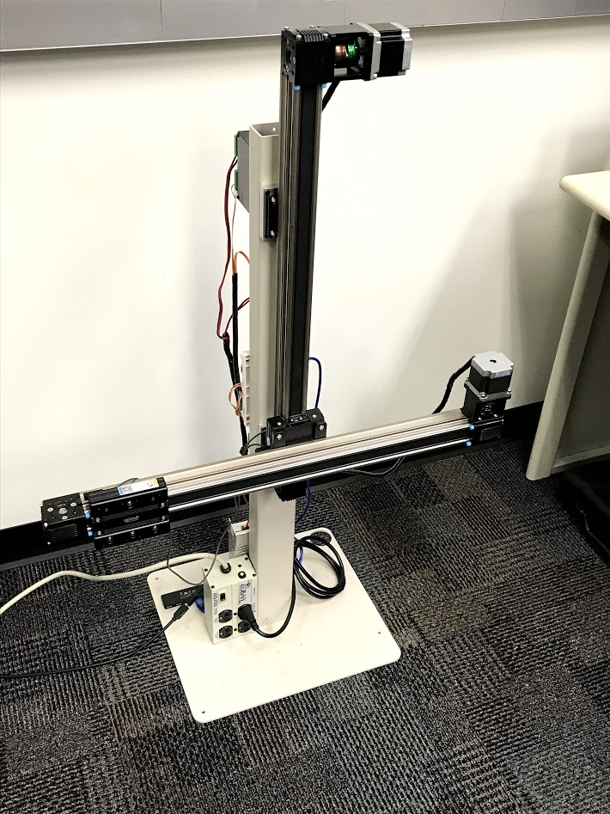
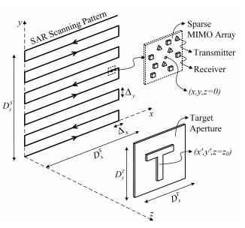
Mechanical Imaging Scanner
2D linear mechanical scanner

Slide 12
Using the Scanner
To simulate the conveyor belt:
Box held stationary
Scan the radar 200mm at 100mm/s capturing every 1mm
Feed range FFT into CNN for two class detection
1000 samples/class
Results:
1mm sampling: 100%
10mm subsampling: 100%
25mm subsampling 100%
-> Visually obvious in the range FFT

Slide 13
Hidden Item Counting

Slide 14
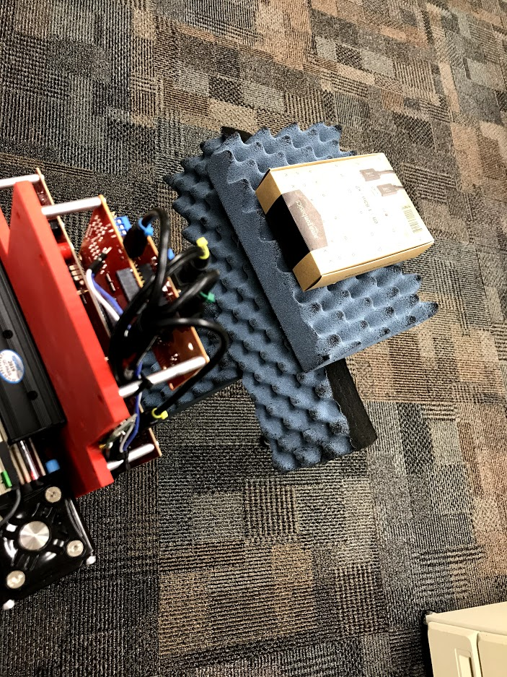
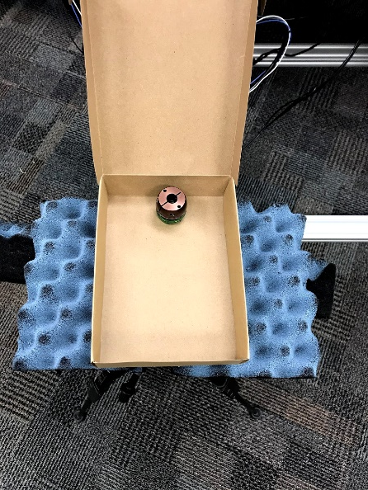
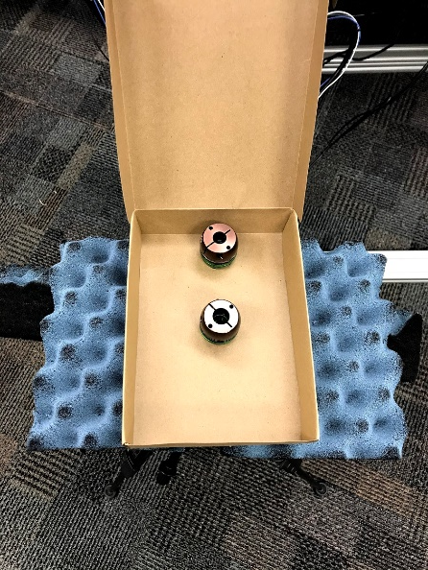
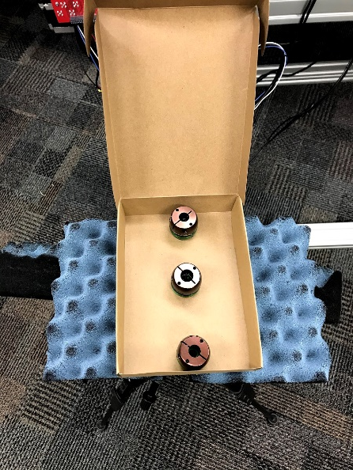
Scenario: Hidden Item Counting
Box moves along conveyor belt at constant speed
Radar gets multiple perspectives of the box as it moves
Four Cases:
No Items
1 Metal Item
2 Metal Items (10cm apart)
3 Metal Items

Slide 15
Using the Scanner
To simulate the conveyor belt:
100 samples/class
Scan the radar 200mm at 100mm/s capturing every 1mm
Feed range FFT into CNN for four class detection
Results:
1mm sampling: 100%
10mm subsampling: 100%
25mm subsampling 100%
-> Still visually observable in the range FFT

Slide 16
Medication Packaging

Slide 17
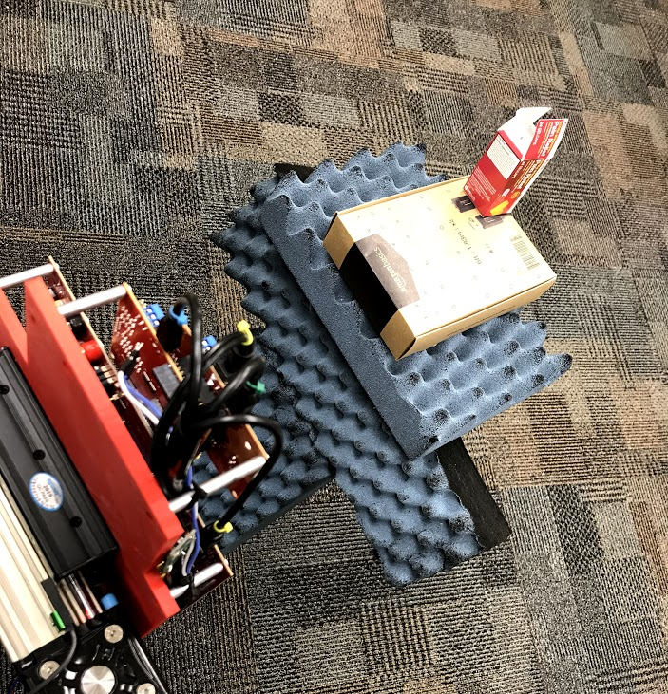
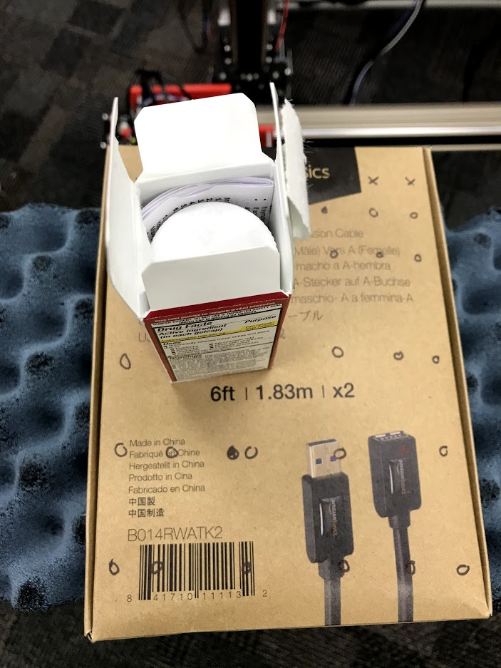
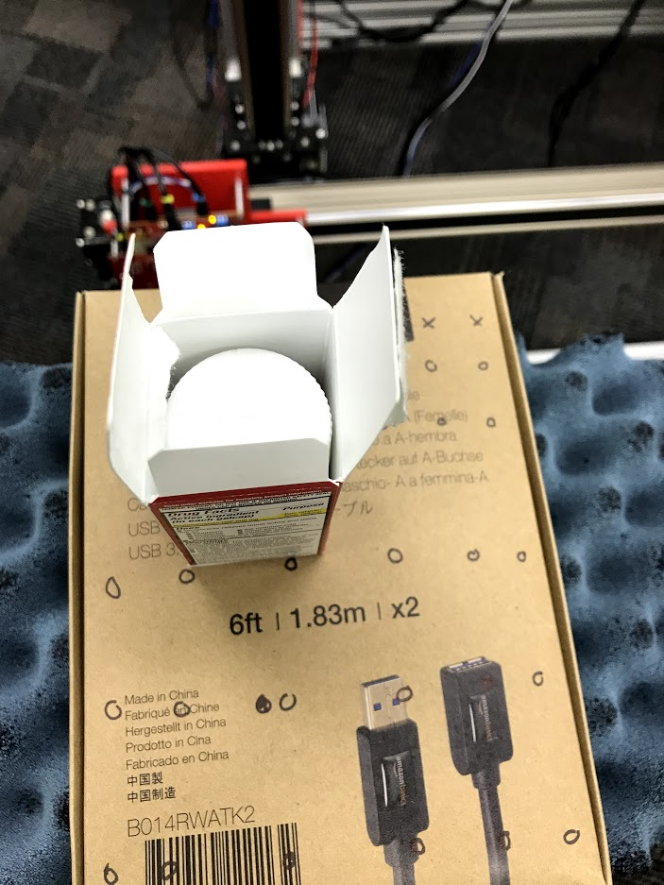
Scenario: Medication Packing
Box moves along conveyor belt at constant speed
Radar gets multiple perspectives of the box as it moves
Box contains:
Pills in bottle and insert
Pills in bottle and no insert

Slide 18
Using the Scanner
To simulate the conveyor belt:
600 samples/class (every 10 box is at different location)
Scan the radar 200mm at 100mm/s capturing every 1mm
Feed range FFT into CNN for four class detection
Results:
1mm sampling: 100%
10mm subsampling: 100%
25mm subsampling 99.7%
-> Very minor change in the range FFT (but detectable by CNN)

Slide 19
Future Applications

Slide 20
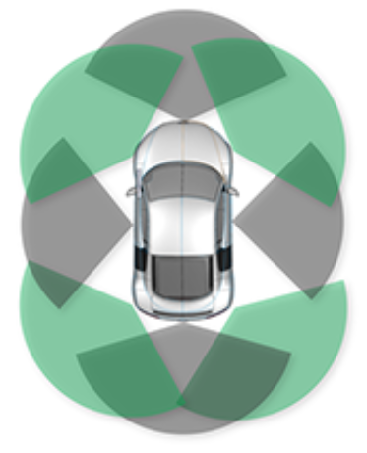
Automotive Scene Classification
Radar continuously capturing images from a moving vehicle
Estimate the range of targets in various environments
Target classification: human, stationary object, another vehicle (stationary or moving)
Initial Steps:
Capture dynamic motions with scanner
Classify human movements
Image Courtesy of TI

Slide 21
Conclusions and Future Work
Using scanner to capture multiple perspectives increases static item classification substantially
More feedback needed for desired applications of THz imager
TxACE-wide project goals/final applications
Ongoing and Future Work
New applications for item detection
Continued synergy among TxACE groups to obtain THz IC
Contacted this week requesting update
Use mechanical scanner for scenario simulation
Cascaded TI EVM Radar

Slide 22

Questions?

